Slide 1
Presentation Title
Smart Plant doctor: Disease classification with CNN-SVM
Presented by
Md. Touhid Islam Shourov
Student Id:1702040
Farah Sultana Fera
Student Id:1702078
Hajee Mohammad Danesh Science and Technology University, Dinajpur-5200

Slide 2
Presentation outline
Introduction
Motivation
Objectives
Challenges
Features
Requirements
Proposed methodology
Implementation
Application Snapshots
Conclusion
Future work
Reference

Slide 3
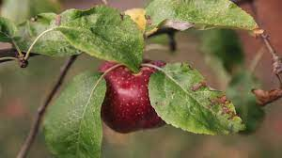
Problem Statement
Damages of exclusive plants
Lacking of proper knowledge about plant disease
Reluctance of getting paid treatment of plants
Failure of detecting plant disease

Slide 4

Introduction
Plant diseases
Food and plant security
Economical loss
Smartphones
Digitalization
Using IT in poor level

Slide 5
Motivation
Gardening in urban area
Make aware the farmers
Ease design to almost every kind user
For saving valuable plants

Slide 6
Objectives of the Project
Disease's detection of fruits and plants
Free treatment of plants
More knowledge about plants diseases
More awareness from eating rotten fruits
Make gardening easier to the urban people
Give an easy solution to the affected plants or leafs
Get prepare to prevent disease.

Slide 7
Challenges
Creating best fit model
Recognition accuracy
Security maintenance
Designing ease layout

Slide 8
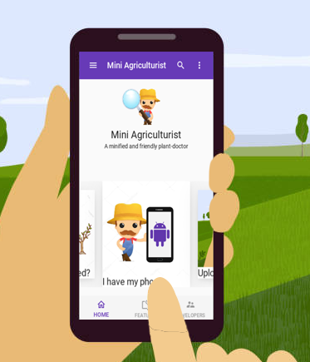
Features of the project
Efficiently disease recognition
Remedy on every disease offered in system
Suspect image scanning
Simple Messaging system
Secure admin control system
Ease android application

Slide 9

Requirements
Functional Requirement
1. Image Dataset
2. Technical Tools
3. Keras
4. Tensorflow
5. CNN (Deep learning)
6. SVM
Non-Functional Requirement
1. Classification of Disease
2. Free treatment/remedy for plant disease

Slide 10
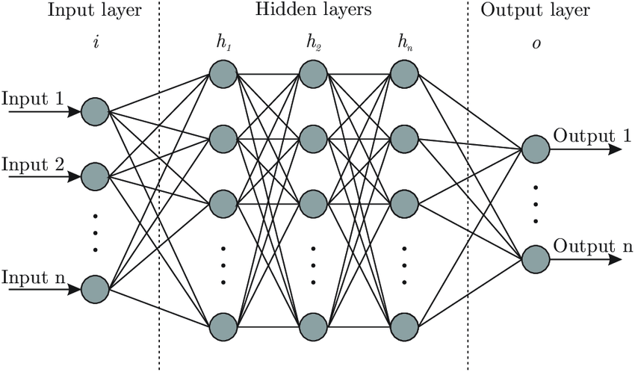
Architecture of ANN model

Slide 11
Working procedure of ANN

Slide 12
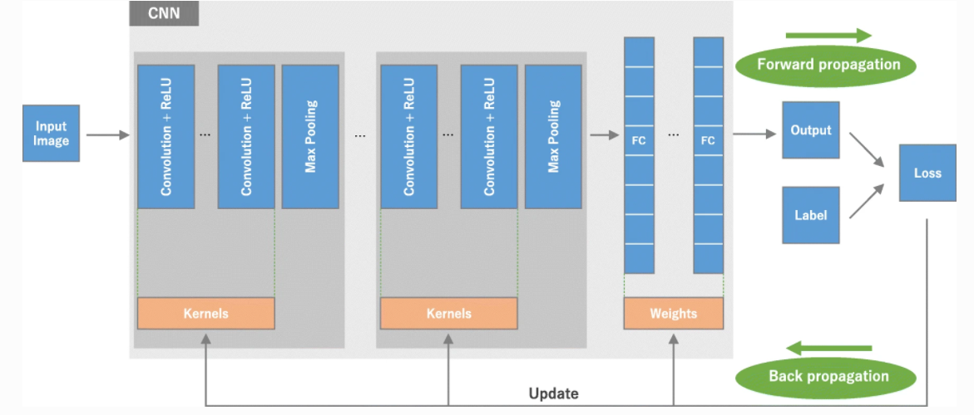
Architecture of CNN model

Slide 13
Convolution Operation
Input image
Filter
Feature map
7 | 2 | 3
4 | 5 | 3
3 | 3 | 2
7 | 2 | 3 | 3 | 8
4 | 5 | 3 | 8 | 4
3 | 3 | 2 | 8 | 4
2 | 4 | 7 | 2 | 7
5 | 8 | 4 | 5 | 4
1 | 0 | -1
1 | 0 | -1
1 | 0 | -1
6
*
=
7*1+4*1+3*1+2*0+5*0+3*0+3*-1+3*-1+2*-1 = 6

Slide 14
Max pooling Operation
9 | 5 | 13 | 33 | 21 | 7
4 | 4 | 8 | 12 | 17 | 2
14 | 12 | 4 | 7 | 2 | 5
3 | 7 | 6 | 9 | 6 | 4
22 | 8 | 3 | 5 | 3 | 15
9 | 21 | 9 | 23 | 5 | 3
9 | 7 | 11
4 | 13 | 11
14 | 7 | 11
Maxpool
2x2 window size
3x3 output
6x6 input

Slide 15
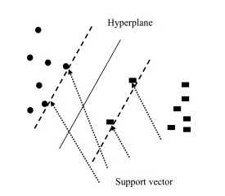
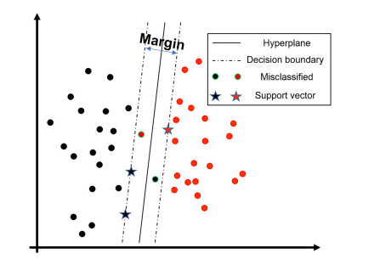
Support vector machine (SVM)
SVM Model No. 1
SVM Model No. 2

Slide 16
Reason for choosing deep learning
Allows machines to identify and extract features from images
Automatic feature deduce and optimal tunning
Efficient performance in image classification
Flexible to be adopted to new problem

Slide 17
Proposed methodology
Load and split dataset
Preprocessing images
Extract the features with CNN
Apply SVM as classifier
Create the model

Slide 18
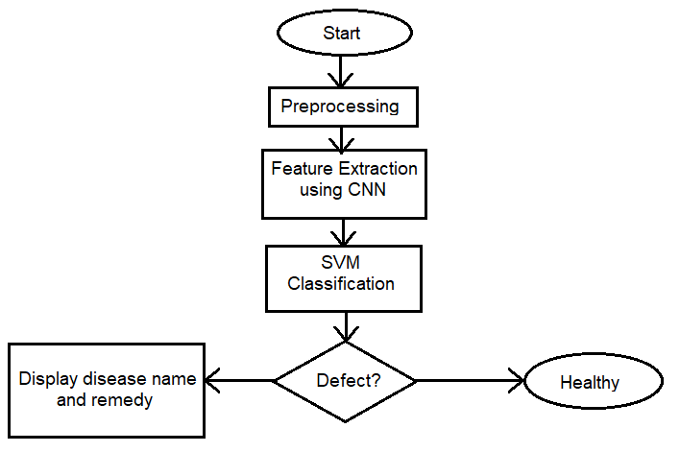
Flow diagram of the system

Slide 19
Use case diagram
Disease recognition
Sign up
Overall control
Users
Login
Messaging
Make/remove sub-admins
admin
View others profile
Sub-admin

Slide 20
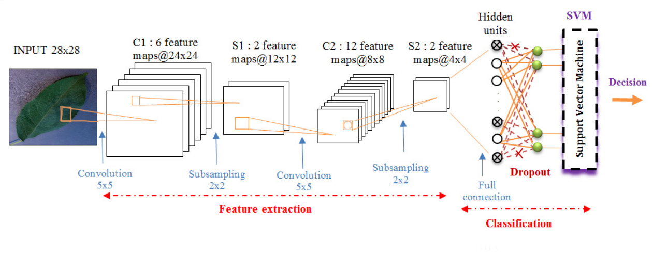
Proposed Architecture Model

Slide 21

Implementation
Collect required dataset
Create the model
Trained the model
Apply the model in android GUI
Test the application
Evaluate full project

Slide 22
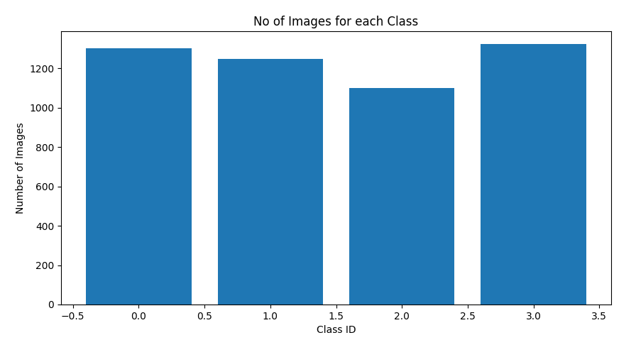
Dataset description
Sample collected from plantVillage dataset
Total 4,306 images used
Number of classes 4

Slide 23
Result Analysis
Test ratio and loss for different algorithms with proposed method
Model | Test accuracy | Loss
SVM | 0.6712 | 0.1785
ANN | 0.8298 | 0.1293
CNN | 0.9670 | 0.0986
ANN-SVM | 0.8984 | 0.1076
Hybrid (CNN-SVM) | 0.9923 | 0.0586

Slide 24
Result Analysis
Experiment on different algorithms with proposed method
Model | Overall accuracy | Kappa accuracy | Average accuracy
SVM | 0.6723 | 0.6689 | 0.6535
ANN | 0.8321 | 0.8212 | 0.8256
CNN | 0.9670 | 0.9670 | 0.9589
ANN-SVM | 0.8934 | 0.8890 | 0.8878
Hybrid (CNN-SVM) | 0.9923 | 0.9843 | 0.9835

Slide 25
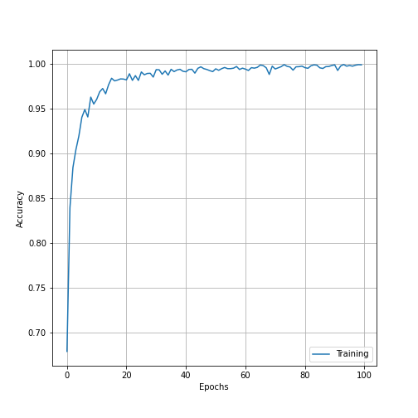
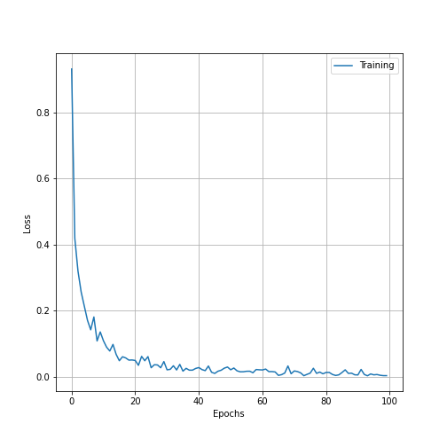
Result Analysis
Accuracy curve and loss curve of proposed method
Accuracy curve Loss curve

Slide 26
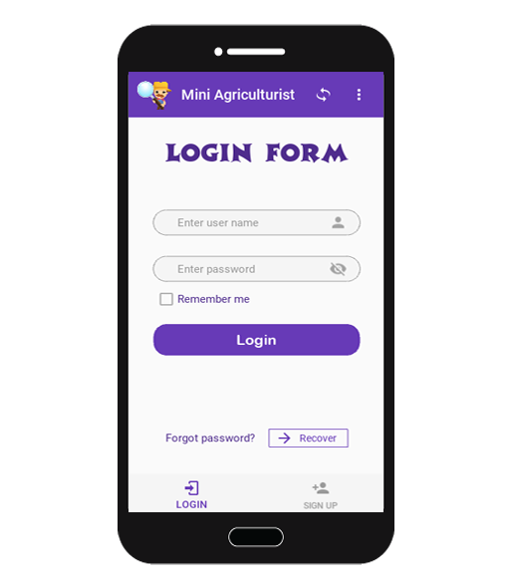
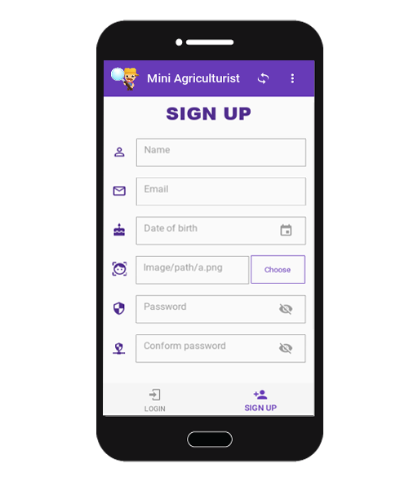
Snapshot of the GUI
Log in layout
Sign up layout

Slide 27
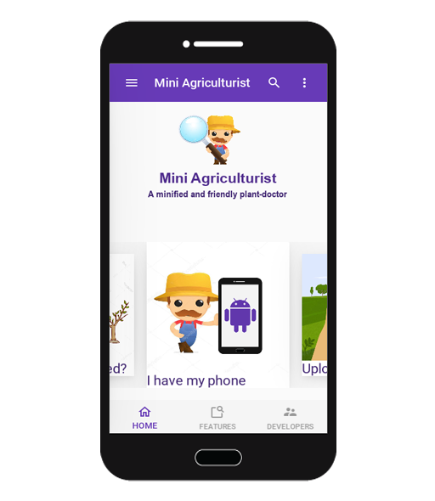
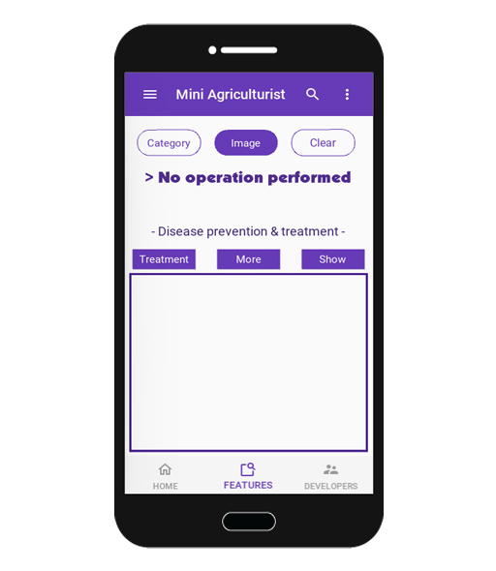
Snapshot of the GUI
Home page
Plant doctor

Slide 28
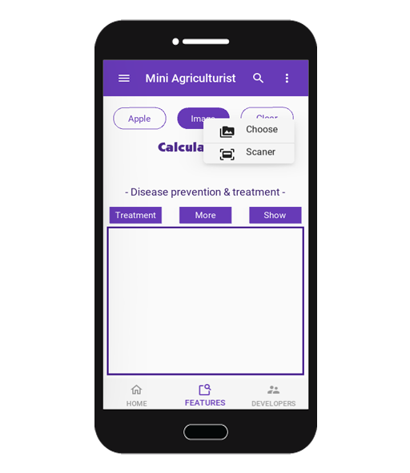
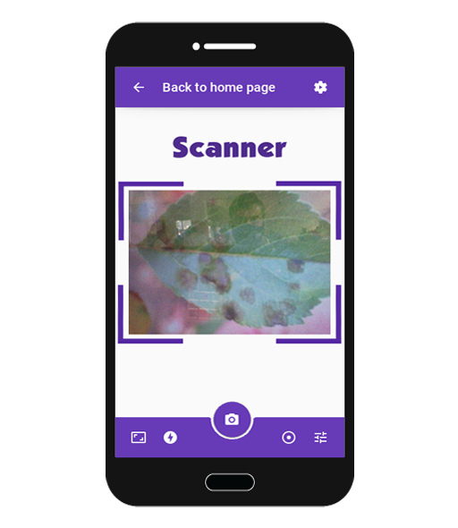
Snapshot of the GUI
Select image in two way
Scanning image

Slide 29
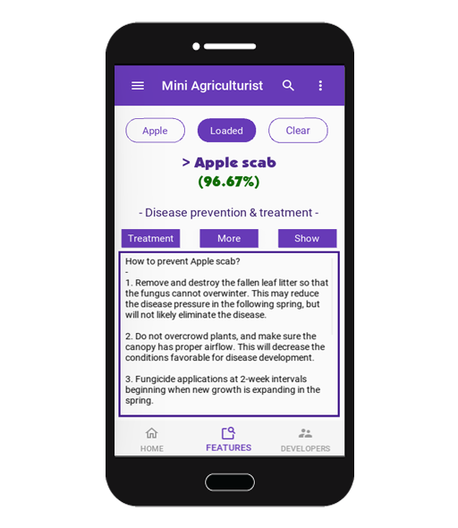
Snapshot of the GUI
-Disease recognition and view the remedy

Slide 30
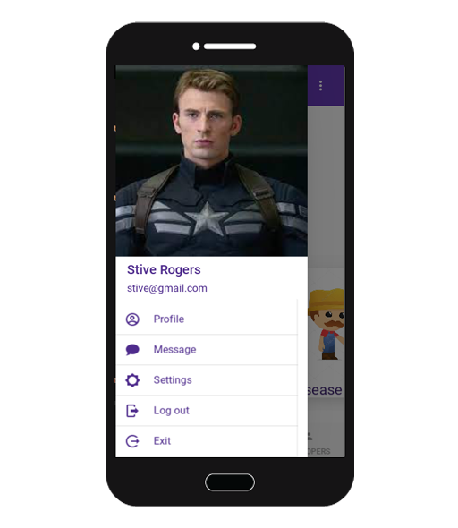

Snapshot of the GUI
Sidebar menu view
View own profile

Slide 31
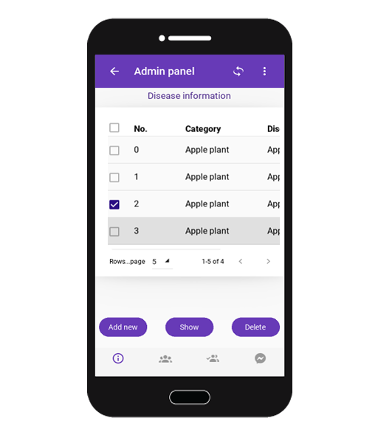
Snapshot of the GUI
Admin panel: Disease information

Slide 32
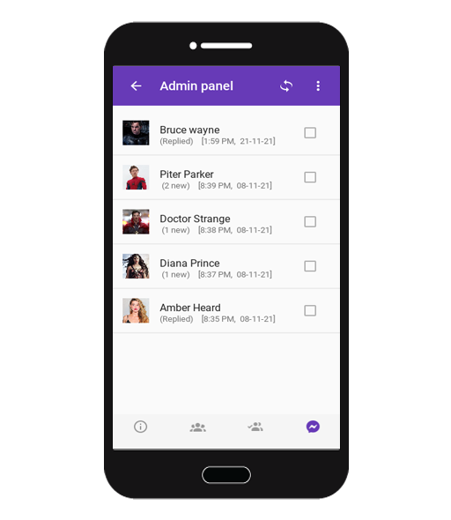
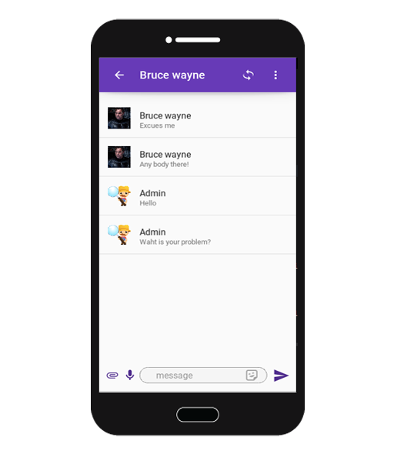
Snapshot of the GUI
Messaging system
Chatting with user

Slide 33
Advantages of the project
Automated system as plant doctor
Communicating features with end user
Secured user information
Ease to control system for admins
Totally free of cost
Cross-platform application

Slide 34
Conclusions
Beneficial for farmers and the plant lovers
Free cost treatment (remedy)
Recognition skill better than human
Simple system for small organization

Slide 35
Future Work
Create a model for more disease class
Use online cloud storage
More efficient user interface
Study on how to increase prediction accuracy

Slide 36
Thank you

